Slide 1
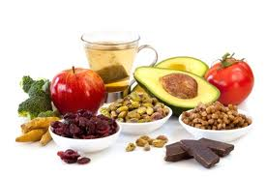
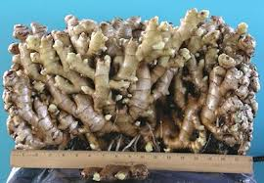
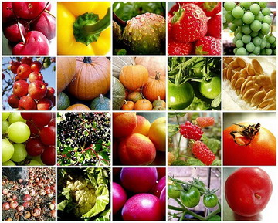
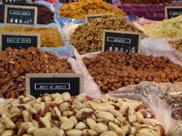
SECTION V (CHAP 16 & 17)
AROMATIC COMPOUNDS

Slide 2
FUNDAMENTAL CONCEPTS
Benzene: Structure and stabilization by resonance
Aromaticity
Nomenclature of benzene derivatives
Reaction at the benzylic position
Electrophilic substitution on aromatic
Activators vs deactivators
Friedel Crafts reaction
Nucleophilic substitution on aromatic
Sandmeyer reactions
Birch reduction
Oxidation of phenols

Slide 3
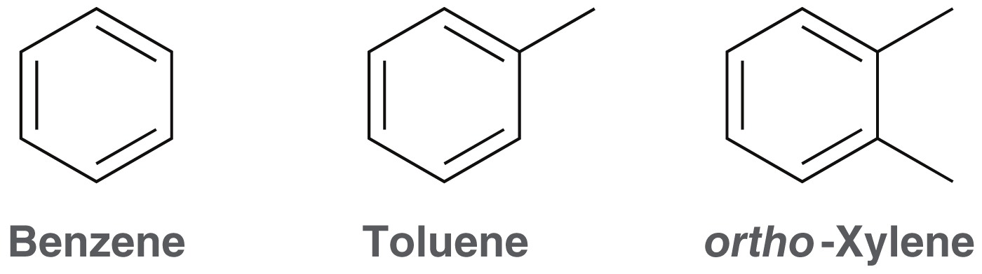
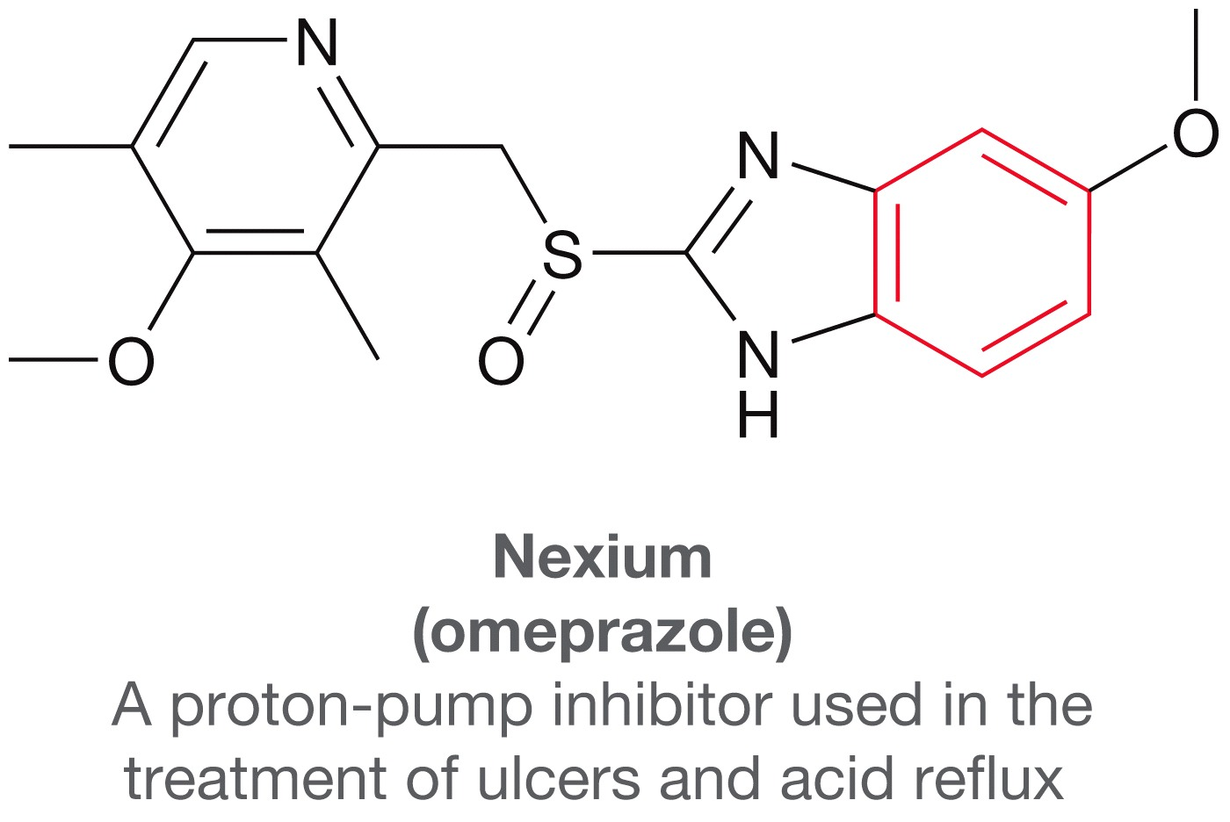
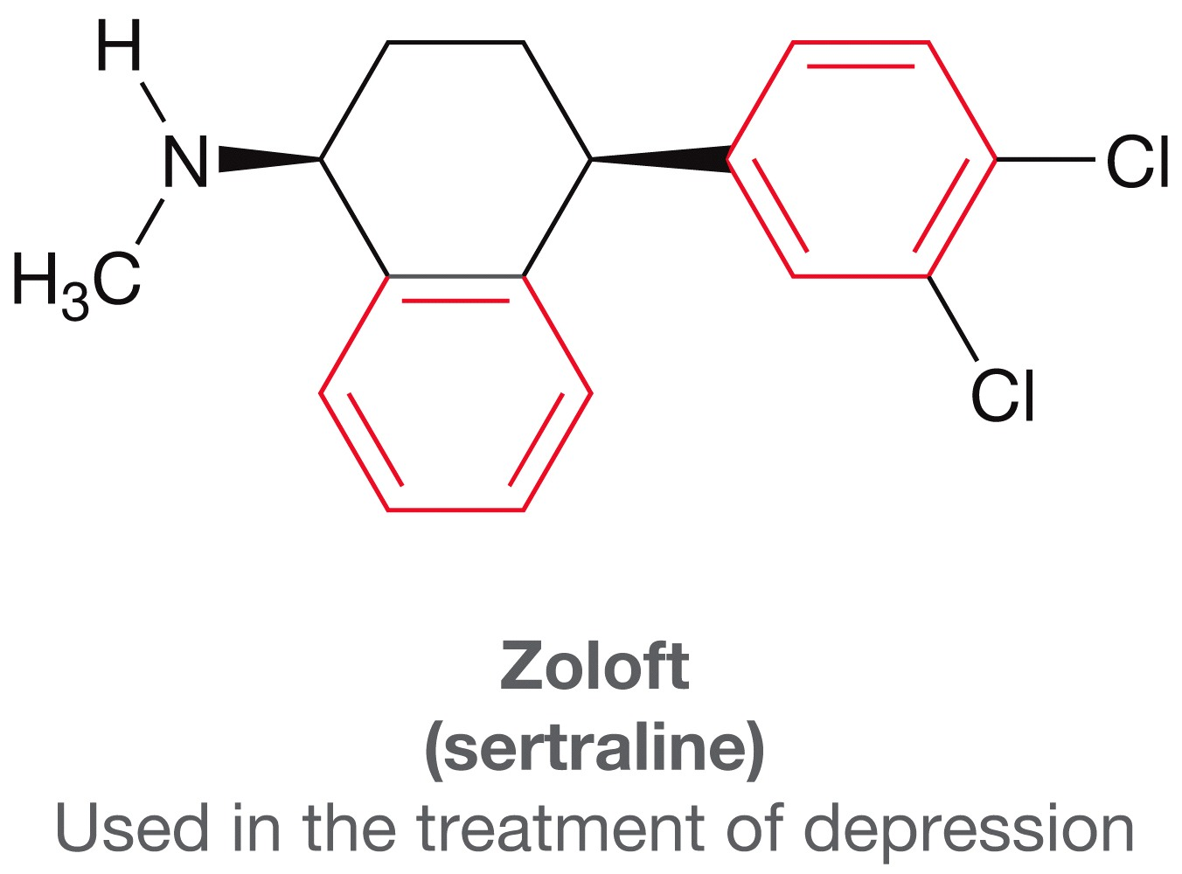
AROMATIC COMPOUNDS
Aromatic compounds or arenes include benzene and benzene derivatives.
Many aromatic compounds were originally isolated from fragrant oils.
However, Aromatic compounds are quite common, and many of them are odorless.
8 of the 10 best-selling drugs have aromatic moieties

Slide 4
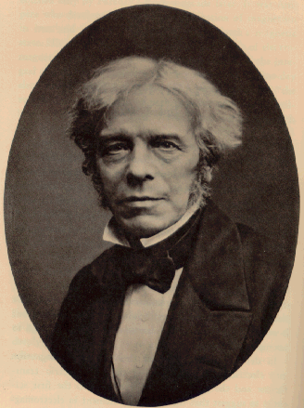
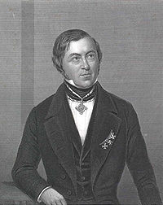
DISCOVERY AND STRUCTURE OF BENZENE
Discovery of Benzene
Benzene was isolated in 1825 by Michael Faraday who determined C:H ratio to be 1:1.
It was first synthesized in 1834 by Eilhard Mitscherlich who determined its molecular formula to be C₆H₆.
Other related compounds with low C:H ratios had a pleasant smell, so they were classified as aromatic in contrast to organic compounds without these properties, called alphatic (fatlike).
Michael Faraday (22 September 1791 – 25 August 1867) English scientist who contributed to the fields of electromagnetism. He discovered electromagnetic induction, diamagnetism and electrolysis.
Eilhard Mitscherlich (7 January 1794 – 28 August 1863) German chemist

Slide 5
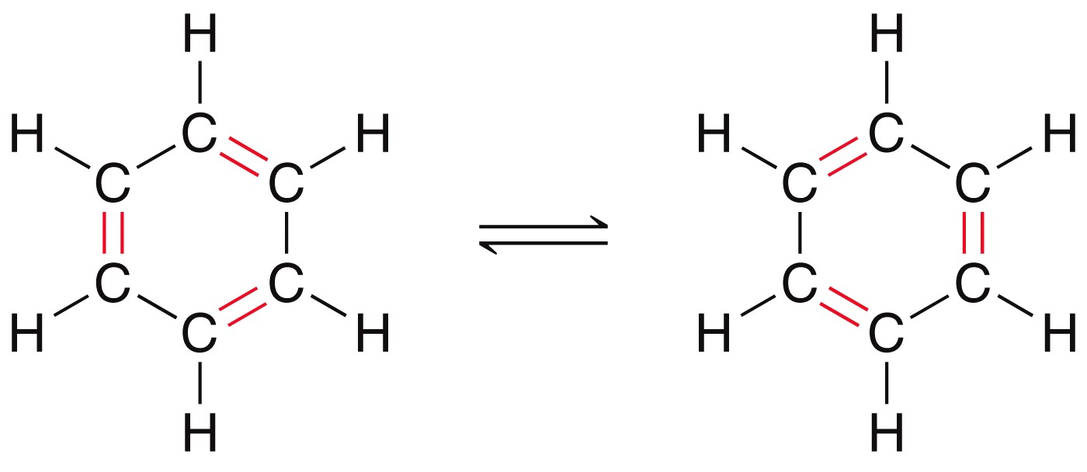
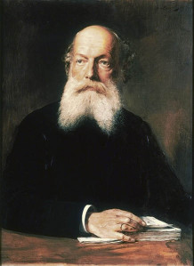
DISCOVERY AND STRUCTURE OF BENZENE
Kekulé Structure
In 1866, Friedrich Kekulé proposed a cyclic structure for benzene with three double bonds, shortly after multiple bonds were suggested.
The Kekulé structure has its own shortcomings, for example, it failed to explain the difference of reactivity between a normal double bond and the aromatic system.
Friedrich August Kekule von Stradonitz
(7 September 1829–13 July 1896), German Chemist

Slide 6
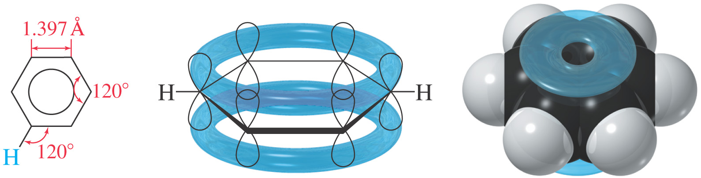
DISCOVERY AND STRUCTURE OF BENZENE
Cyclohexa-1,3-diene
Benzene

Slide 7
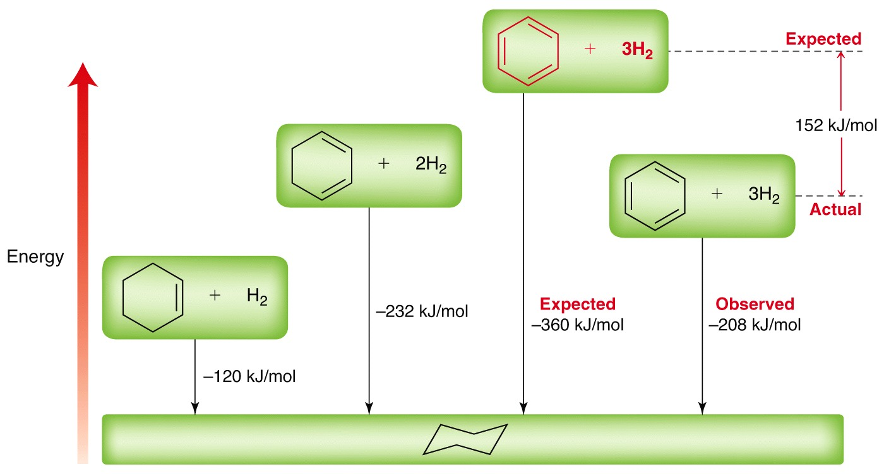
DISCOVERY AND STRUCTURE OF BENZENE
Unusual Stability
The hydrogenation of cyclohexene is exothermic by 120 kJ/mol
The hydrogenation of 1,4-cyclohexadiene is exothermic by 240 kJ/mol, about twice the heat hydrogenation of cyclohexene
The hydrogenation of 1,3-cyclohexadiene is exothermic by 232 kJ/mol, still about twice the heat hydrogenation of cyclohexene

Slide 8
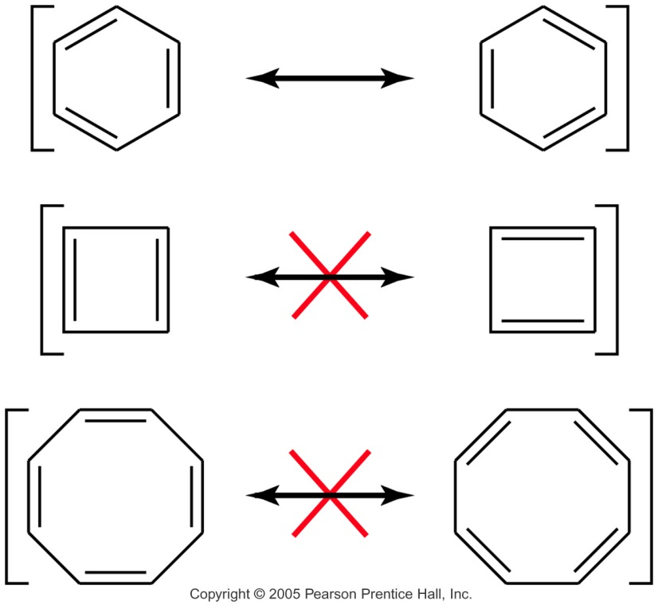
AROMATICITY AND POLYENE SYSTEMS
Annulenes
Annulenes are hydrocarbons with alternating single and double bonds.
Benzene is a six-membered annulene, so it can be named [6]-annulene. Cylobutadiene is [4]-annulene, cyclooctatetraene is [8]-annulene
All cyclic conjugated hydrocarbons were proposed to be aromatic
However, cyclobutadiene is so reactive that it dimerizes before it can be isolated
And cyclooctatetraene adds Br₂ readily
Look at MO’s to explain aromaticity
MO Rules for Benzene
Six overlapping p orbitals must form six molecular orbitals.
Three will be bonding, three antibonding.
Lowest energy MO will have all bonding interactions, no nodes.
As energy of MO increases, the number of nodes increases

Slide 9
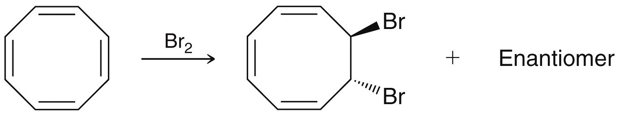
AROMATICITY AND POLYENE SYSTEMS
Annulenes
Some fully conjugated cyclic compounds are reactive rather than being stable like benzene
MO’s and Energy Diagram for Benzene
The first MO of benzene is entirely bonding with no nodes.
It has very low energy because it has six bonding interactions and the electrons are delocalized over all six carbon atoms
The intermediate levels are degenerate (equal in energy) with two orbitals at each energy level.
Both π2 and π3 have one nodal plane

Slide 10
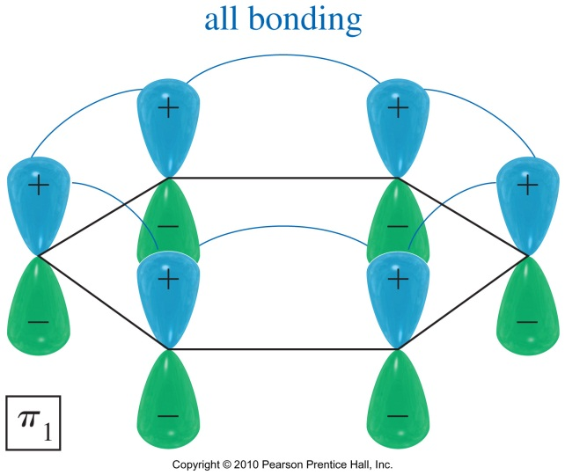
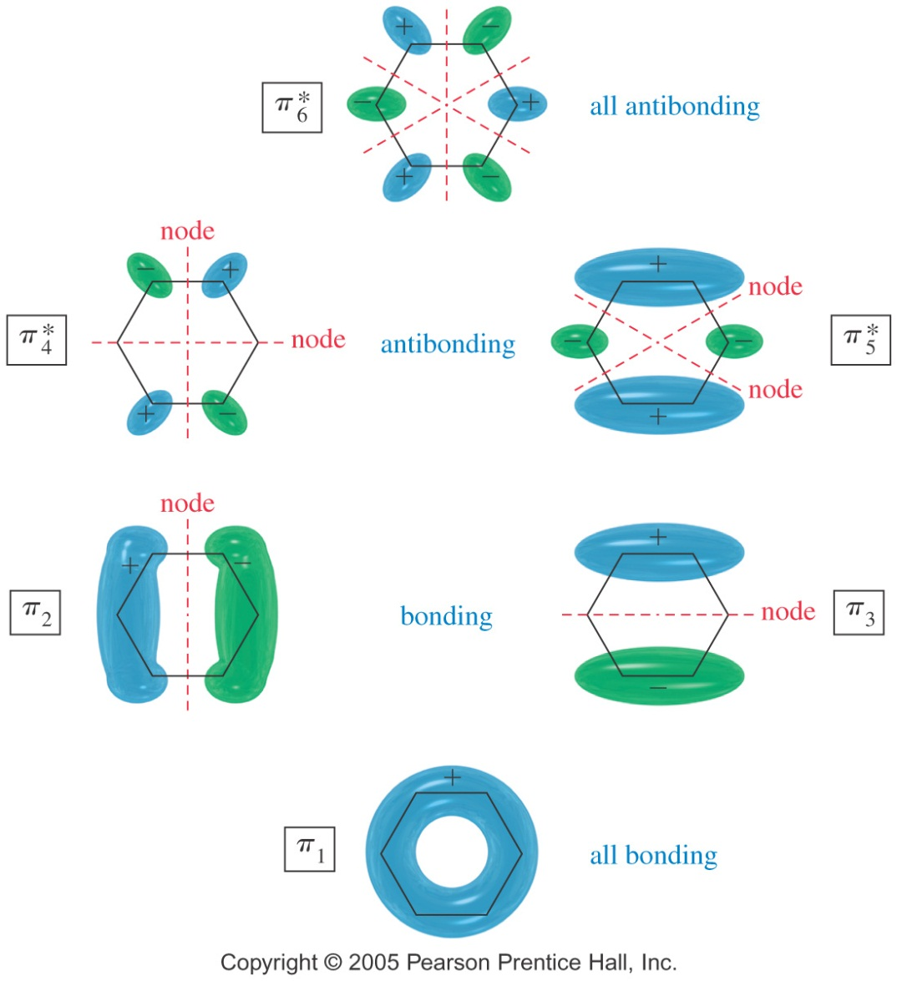
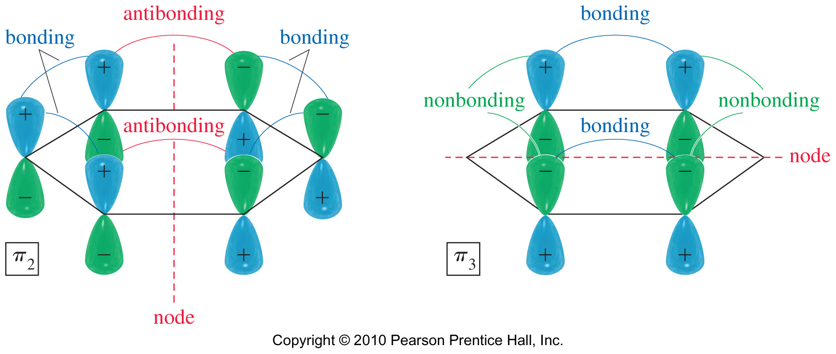
AROMATICITY AND POLYENE SYSTEMS
MO’s and Energy Diagram for Benzene

Slide 11
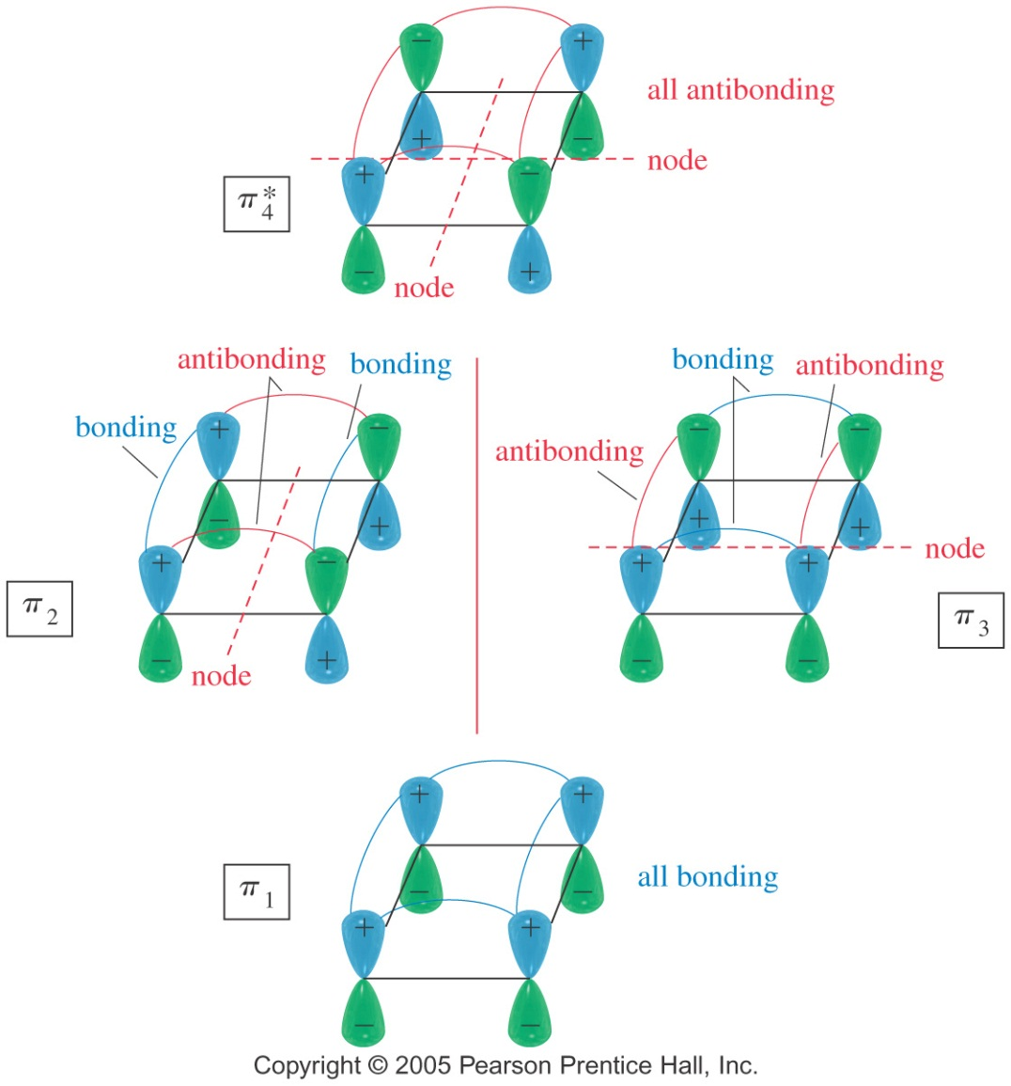
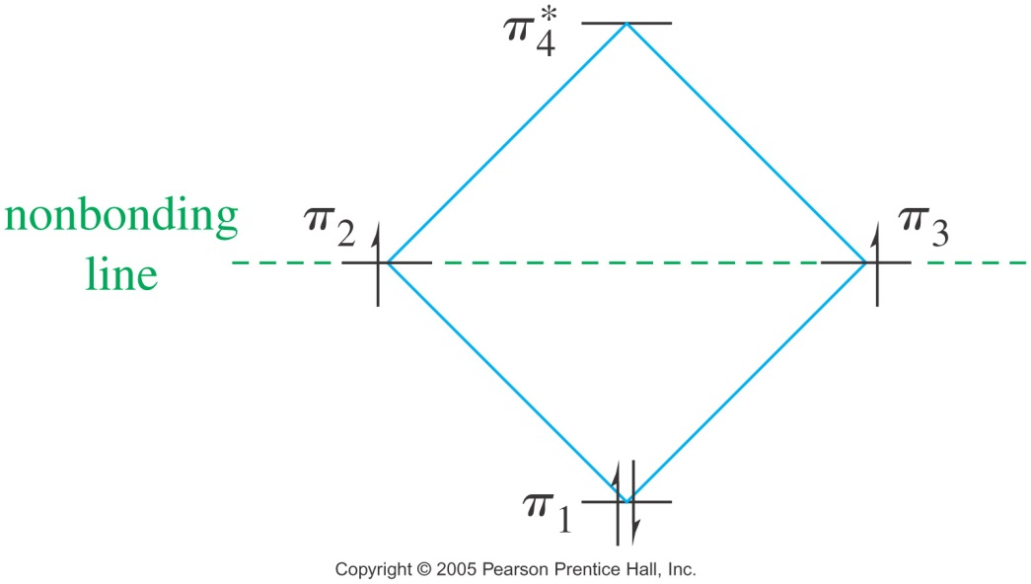
AROMATICITY AND POLYENE SYSTEMS
MO’s and Energy Diagram for Cyclobutadiene
Following Hund’s rule, two electrons are in separate orbitals.
This diradical would be very reactive

Slide 12
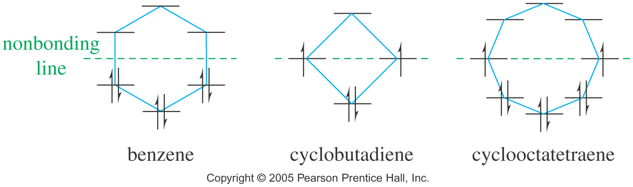
AROMATICITY AND POLYENE SYSTEMS
The Frost circles
The energy diagram for an annulene has the same shape as the cyclic compound with one vertex at the bottom.
Aromatic Requirements
Structure must be cyclic with conjugated pi bonds.
Each atom in the ring must have an unhybridized p orbital (sp2 or sp).
The p orbitals must overlap continuously around the ring. Structure must be planar (or close to planar for effective overlap to occur)
Delocalization of the pi electrons over the ring must lower the electronic energy.

Slide 13
AROMATICITY AND POLYENE SYSTEMS
Anti- and Nonaromatic
Antiaromatic compounds are cyclic, conjugated, with overlapping p orbitals around the ring, but the energy of the compound is greater than its open-chain counterpart.
Nonaromatic compounds do not have a continuous ring of overlapping p orbitals and may be nonplanar.
Hückel’s Rule
To qualify as aromatic or antiaromatic, a cyclic compound must have a continuous ring of overlapping p orbitals, usually in a planar conformation.
If the compound has a continuous ring of overlapping p orbitals and has 4N + 2 electrons, it is aromatic.
If the compound has a continuous ring of overlapping p orbitals and has 4N electrons, it is antiaromatic
Where N is an integer

Slide 14
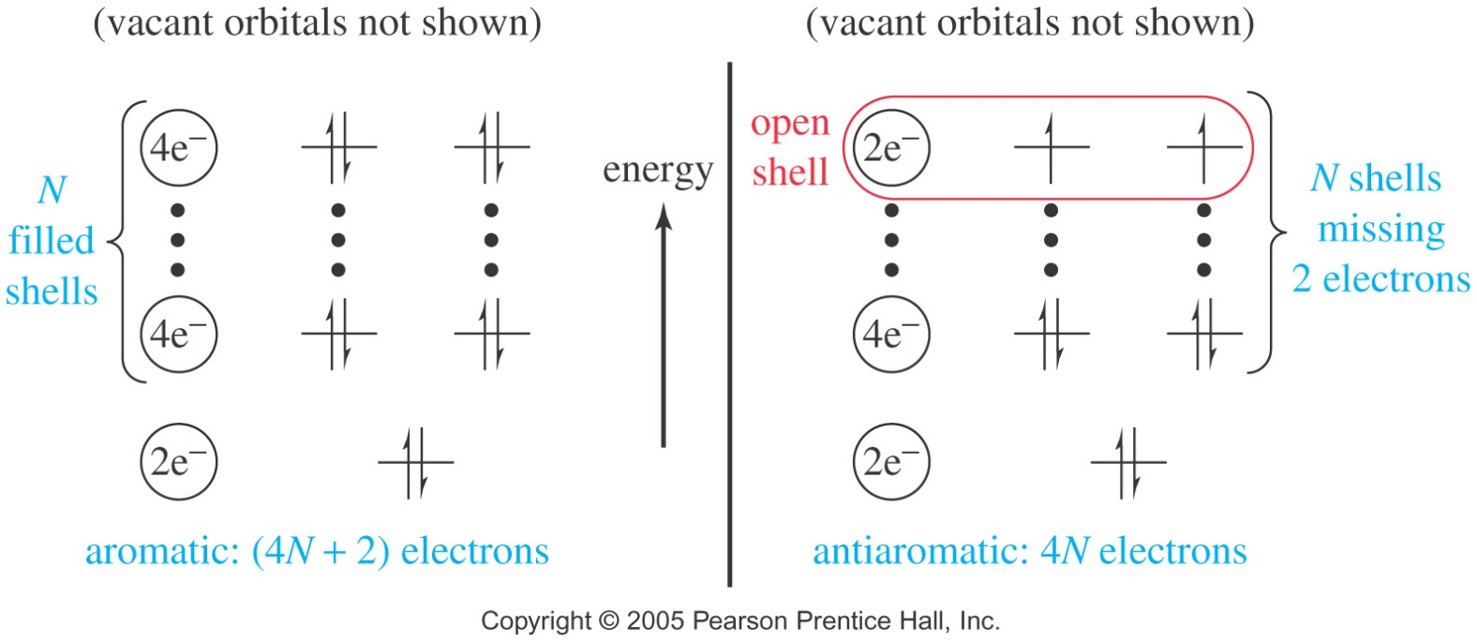
AROMATICITY AND POLYENE SYSTEMS
[N]Annulenes
[4]Annulene is antiaromatic (4N e-’s)
[8]Annulene would be antiaromatic, but it’s not planar, so it’s nonaromatic.
[10]Annulene is aromatic except for the isomers that are not planar.
Larger 4N annulenes are not antiaromatic because they have the flexibility to adopt nonplanar conformations. Even though [12]annulene, [16]annulene, and [20]annulene are 4N systems, they all reacts as partially conjugated polyenes.
MO Derivation of Hückel’s Rule
Lowest energy MO has 2 electrons. Each filled shell has 4 electrons

Slide 15
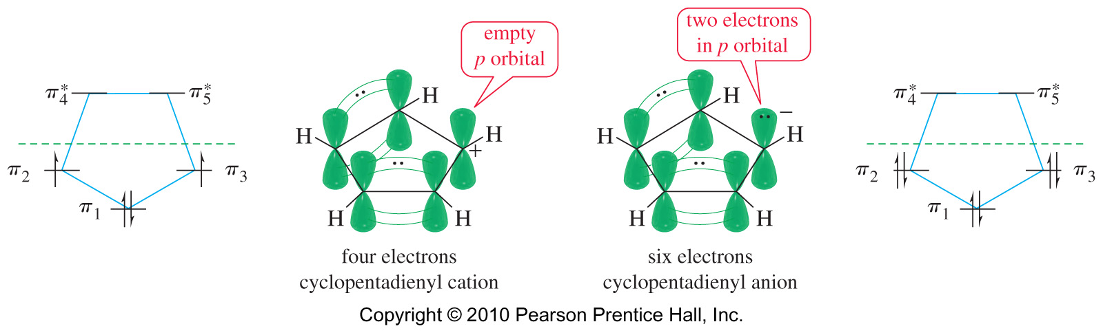
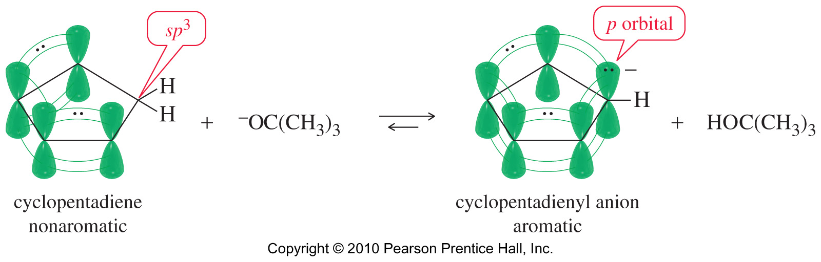
AROMATICITY AND POLYENE SYSTEMS
Cyclopentadienyl Ions
The cation has an empty p orbital, 4 electrons, so antiaromatic.
The anion has a nonbonding pair of electrons in a p orbital, 6 e-’s, aromatic.

Slide 16
AROMATICITY AND POLYENE SYSTEMS
Tropylium Ion
The cycloheptatrienyl cation has 6p electrons and an empty p orbital, and is more stable than open chain ion; it is aromatic.
Other annulenes
Cyclooctatetraene easily forms a -2 ion. Ten electrons, continuous overlapping p orbitals, so it is aromatic.

Slide 17
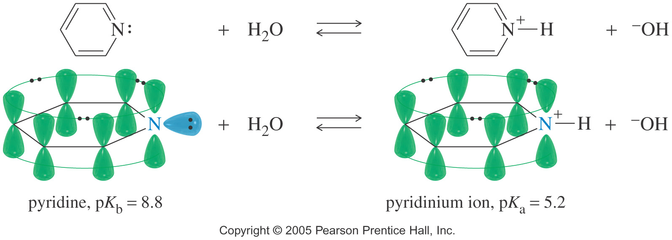
AROMATICITY AND POLYENE SYSTEMS
Pyridine
Pyridine is a heterocyclic aromatic compound, with a nonbonding pair of electrons in sp² orbital, so it is also weak base, pKb = 8.8.
Pyridine is basic, with a pair non-bonding electrons available to abstract a proton.
The protonated pyridine (the pyridinium ion) is still aromatic

Slide 18
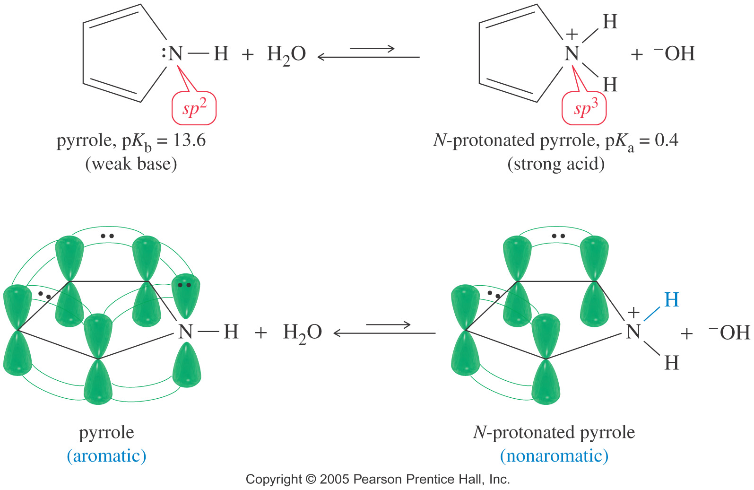
AROMATICITY AND POLYENE SYSTEMS
Pyrrrole
The pyrrole nitrogen atom is sp² hybridized with a lone pair of electrons in the p orbital.
This p orbital overlaps with the p orbitals of the carbon atoms to form a continuous ring.
Pyrrole is aromatic because it has 6 pi electrons (N = 1).

Slide 19
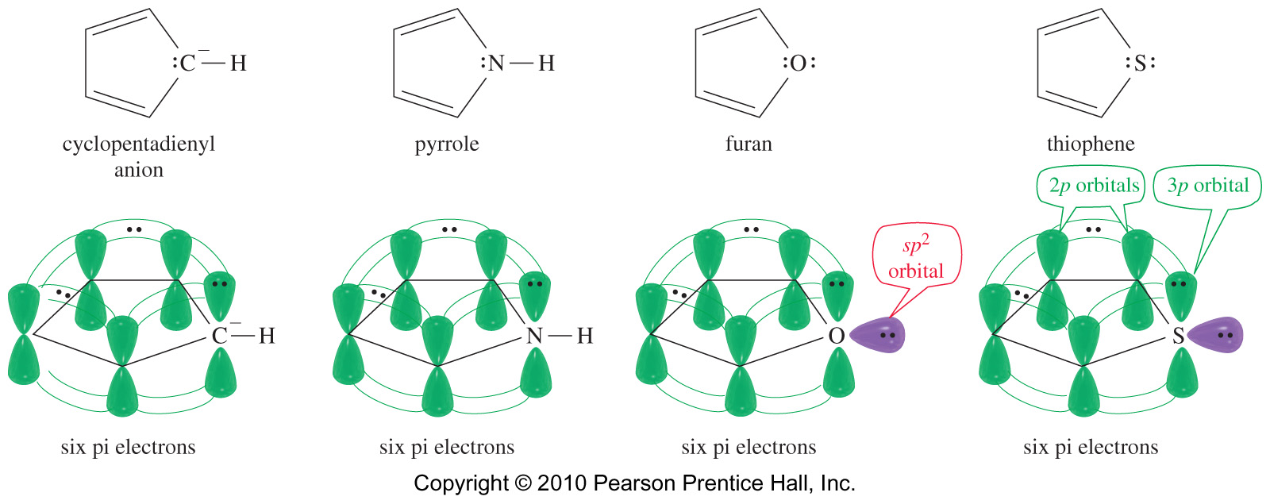
AROMATICITY AND POLYENE SYSTEMS

Slide 20
AROMATICITY AND POLYENE SYSTEMS
Classify each of the following molecules as aromatic, antiaromatic or nonaromatic.
For the aromatic and antiaromatic species, give the number of pi electrons in the ring
Practice 18.8 P. 842, 18.11 P. 848, 18.15 to 18.17 P. 850-851
Problems 18.34, 18.36, 18.38 P. 868-869

Slide 21
FUSED RING HYDROCARBONS

Slide 22
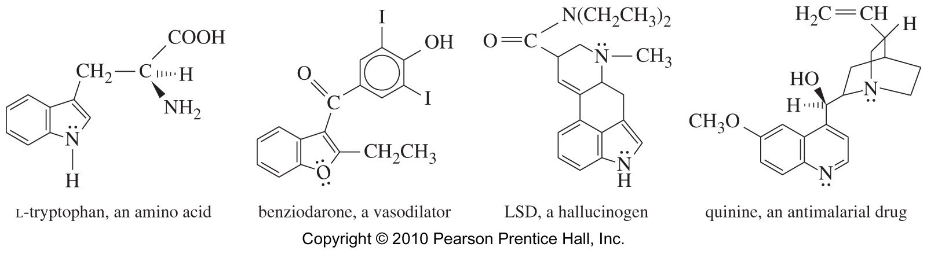
FUSED RING HYDROCARBONS
As the number of aromatic rings increases, the resonance energy per ring decreases, so larger PAH’s will add Br₂
Fused Heterocyclic Compounds
Common in nature, synthesized for drugs

Slide 23
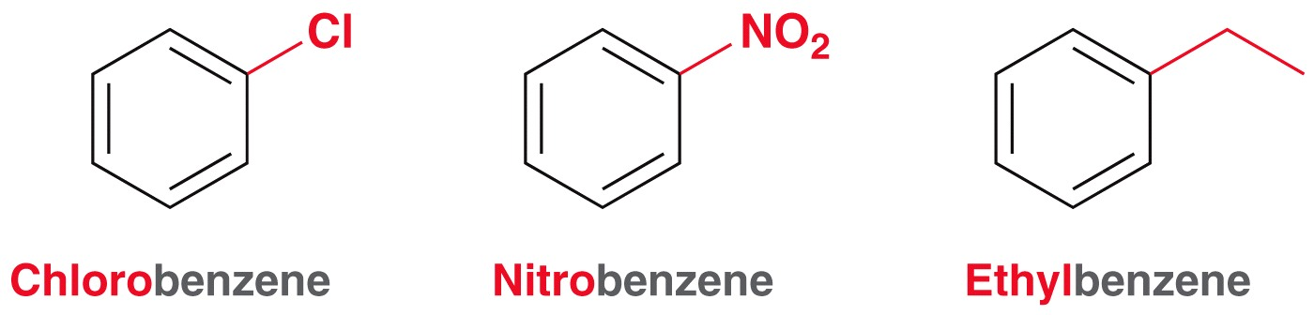
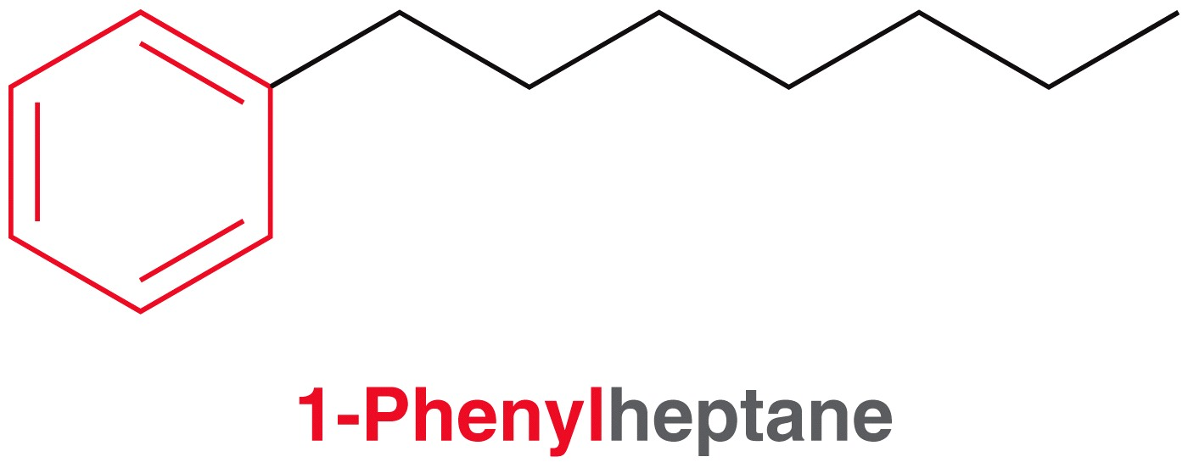
NAMING BENZENE DERIVATIVES
Common Names of Benzene Derivatives

Slide 24
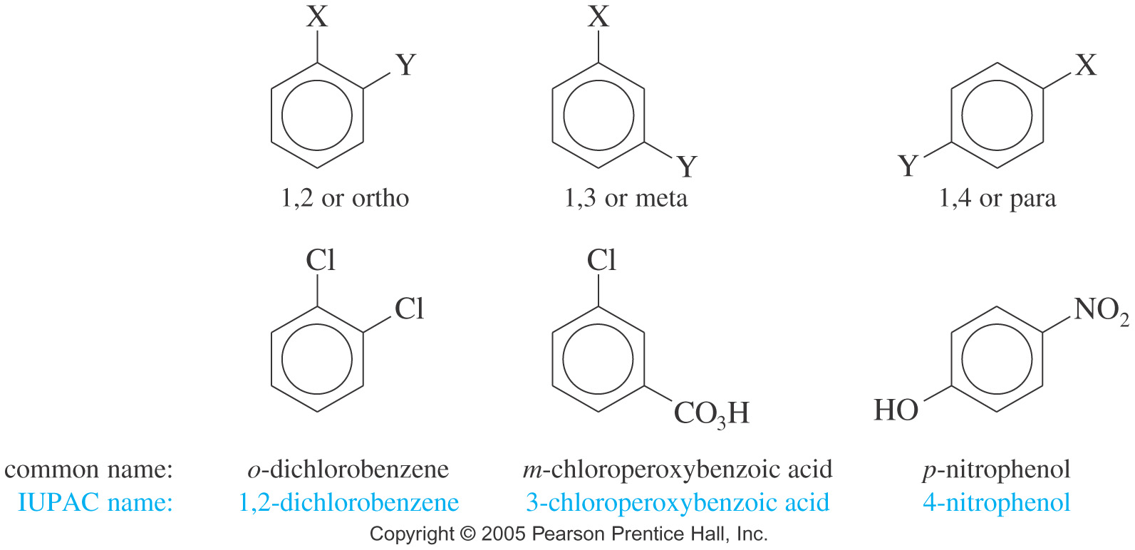
NAMING BENZENE DERIVATIVES
Disubstituted Benzenes
The prefixes ortho-, meta-, and para- are commonly used for the 1,2-, 1,3-, and 1,4- positions, respectively

Slide 25
NAMING BENZENE DERIVATIVES
Benzenes with 3 or More Substituents
Use the smallest possible numbers, but the carbon with the main functional group is #1.
Common Names for polysubstituted Benzenes

Slide 26
NAMING BENZENE DERIVATIVES
Examples: Name the following compounds
Practice 18.1 to 18.4 P. 837
Problems 18.28 to 18.31 P. 868

Slide 27
PHYSICAL PROPERTIES
Melting points: More symmetrical than corresponding alkane, pack better into crystals, so higher melting points.
Boiling points: Dependent on dipole moment, so ortho > meta > para, for disubstituted benzenes.
Density: More dense than nonaromatics, less dense than water.
Solubility: Generally insoluble in water
IR AND NMR SPECTROSCOPY
C=C stretch absorption at 1600 cm⁻¹.
sp² C-H stretch just above 3000 cm⁻¹.
¹H NMR at δ7-δ8 for H’s on aromatic ring.
¹³C NMR at δ120-δ150, similar to alkene carbons

Slide 28
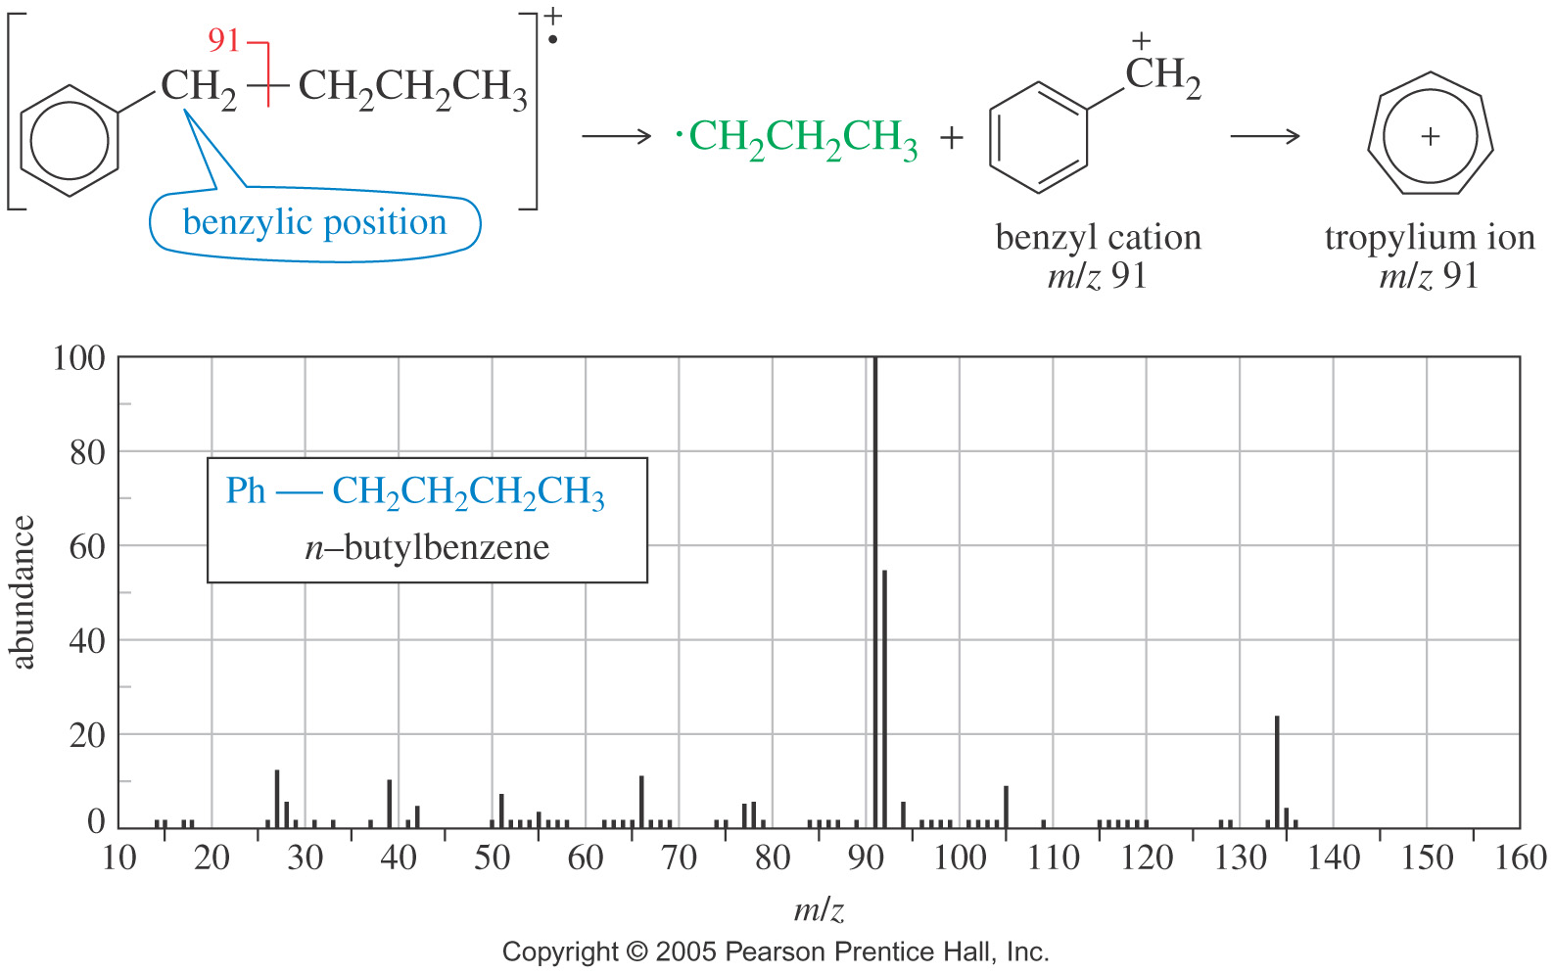
MASS SPECTROMETRY
Mass Spectrometry
Problems 18.59, 18.60 P. 870-871

Slide 29
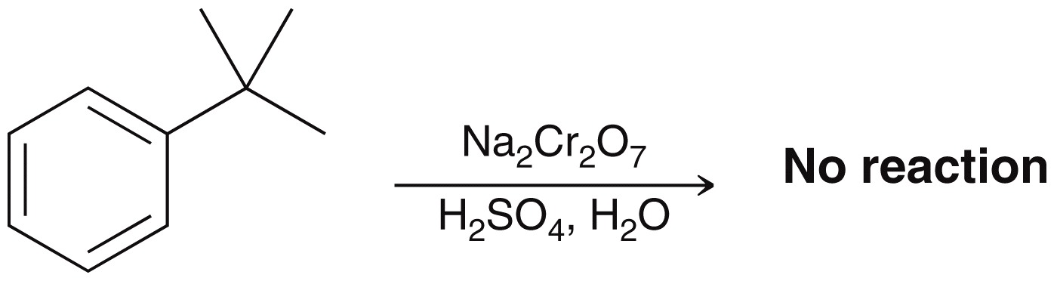
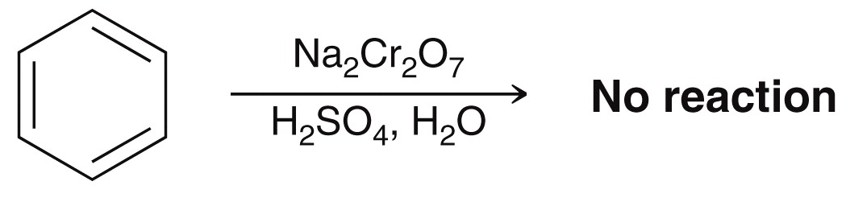
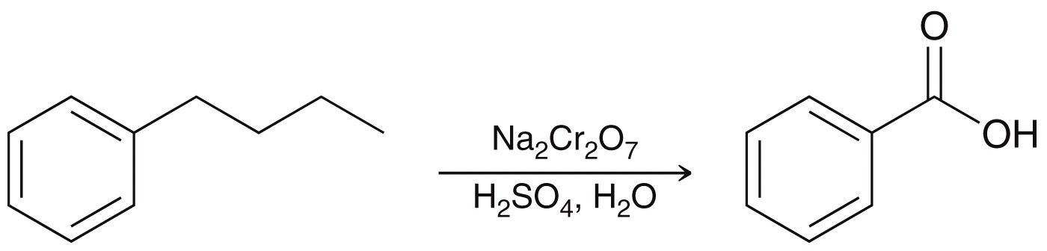
Reactions at the Benzylic Position
In general, benzylic positions can readily be fully oxidized to benzoic acid by hot KMnO₄ or Na₂Cr₂O₇/H₂SO₄
Practice 18.19 P. 855

Slide 30
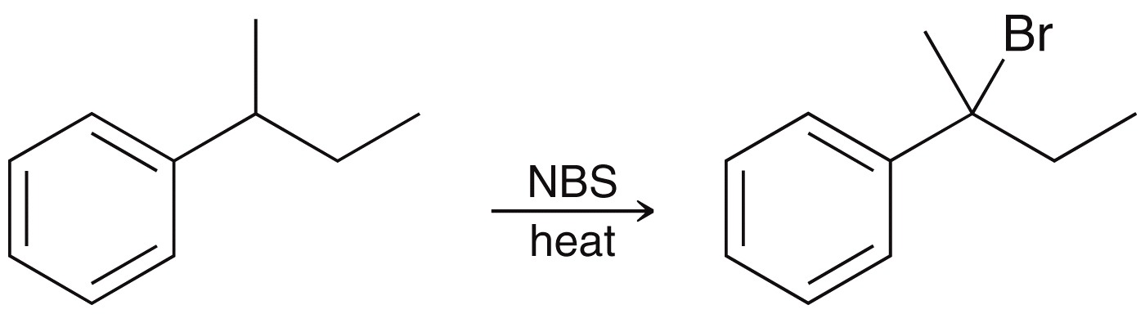
Reactions at the Benzylic Position
The benzylic position is the most reactive.
Br₂ reacts only at the benzylic position.
Cl₂ is not as selective as bromination, so results in mixtures

Slide 31
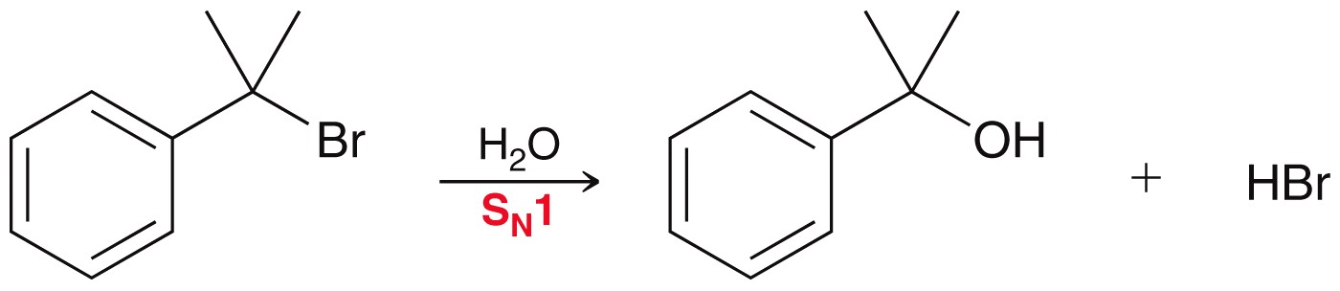
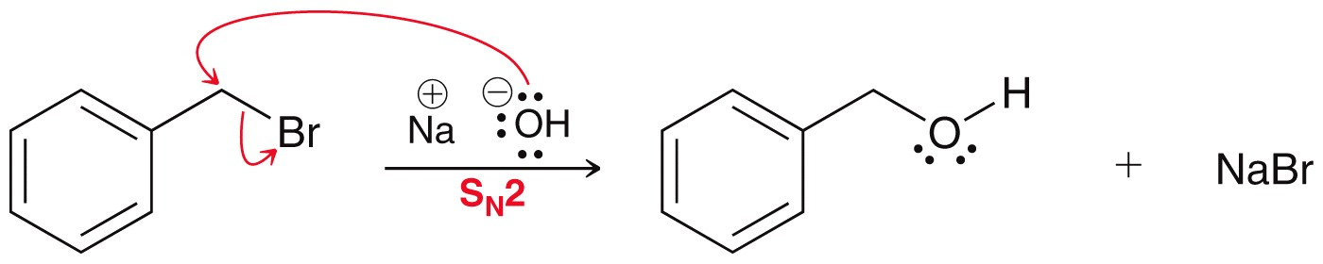
Reactions at the Benzylic Position
Substitution reactions
Benzylic carbocations are resonance-stabilized, easily formed. Thus, benzyl halides undergo SN1 reactions easily.
Benzylic halides are also 100 times more reactive than primary halides via S_{N}2.

Slide 32
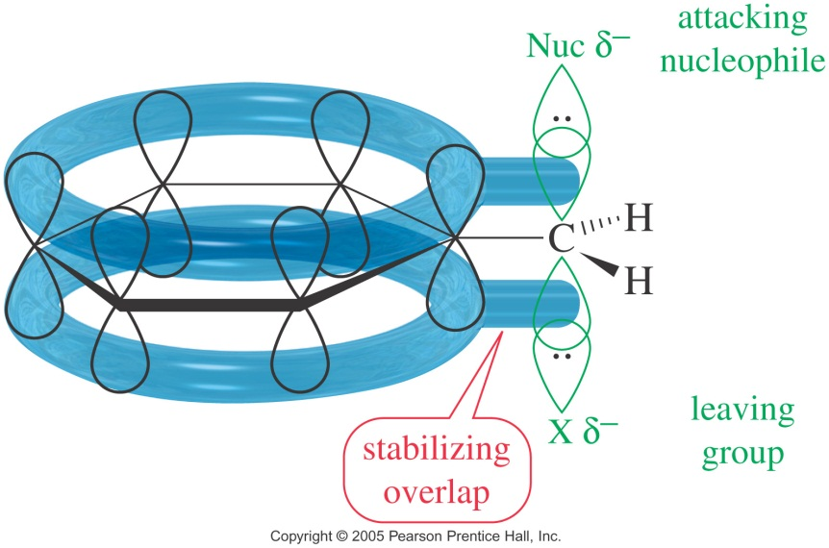
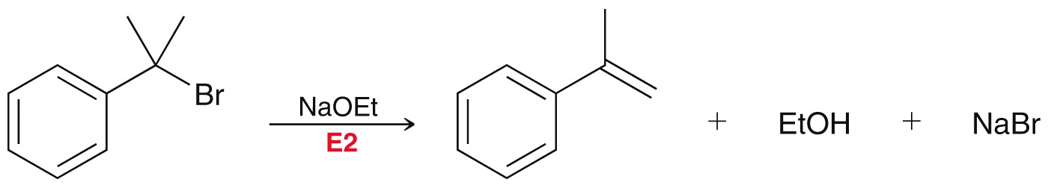
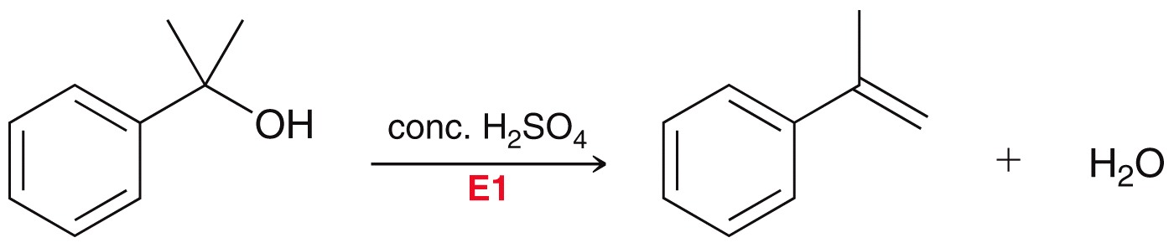
Reactions at the Benzylic Position
Elimination reactions
Practice 18.20 to 18.23 P. 857-858
Problems 18.47 to 18.49 P. 869, 18.58 P. 870

Slide 33
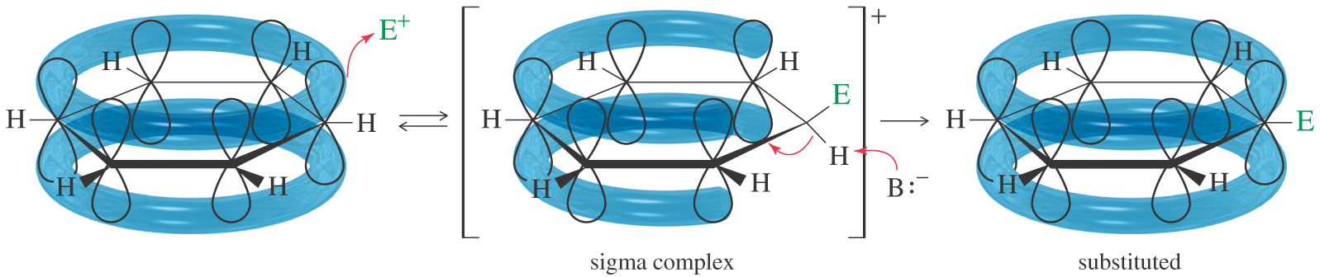
ELECTROPHILIC AROMATIC SUBSTITUTION
Electrophilic Aromatic Substitution
Although benzene’s pi electrons are in a stable aromatic system, they are available to attack a strong electrophile to give a carbocation.
This resonance-stabilized carbocation is called a sigma complex because the electrophile is joined to the benzene ring by a new sigma bond.
Aromaticity is regained by loss of a proton
Electrophile substitutes for a hydrogen on the benzene ring.

Slide 34
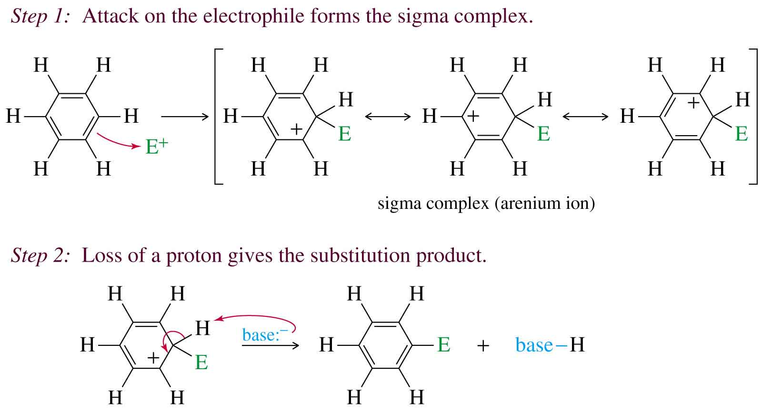
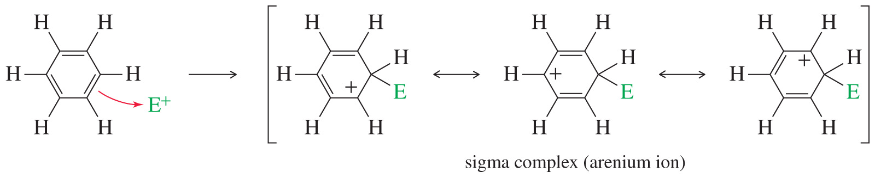
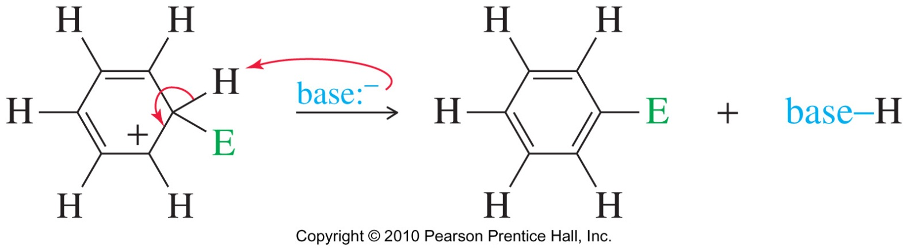
ELECTROPHILIC AROMATIC SUBSTITUTION
Mechanism

Slide 35
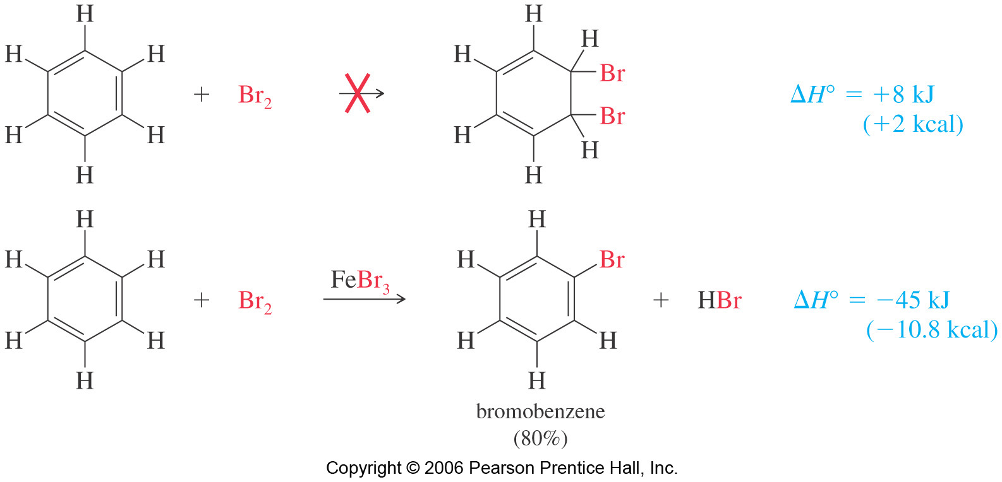
ELECTROPHILIC AROMATIC SUBSTITUTION
Bromination of Benzene
Requires a stronger electrophile than Br₂.
Use a strong Lewis acid catalyst, FeBr₃

Slide 36
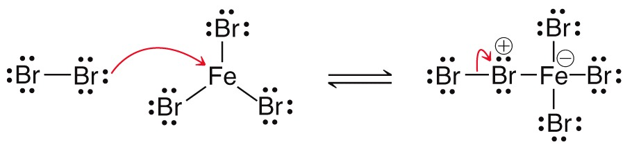
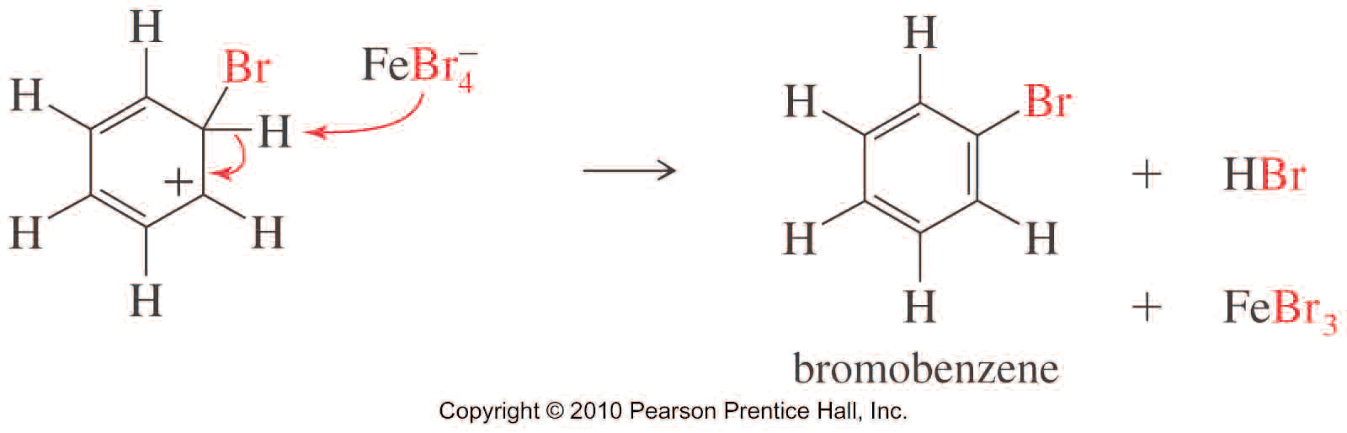
ELECTROPHILIC AROMATIC SUBSTITUTION
Bromination of Benzene (Mechanism)

Slide 37
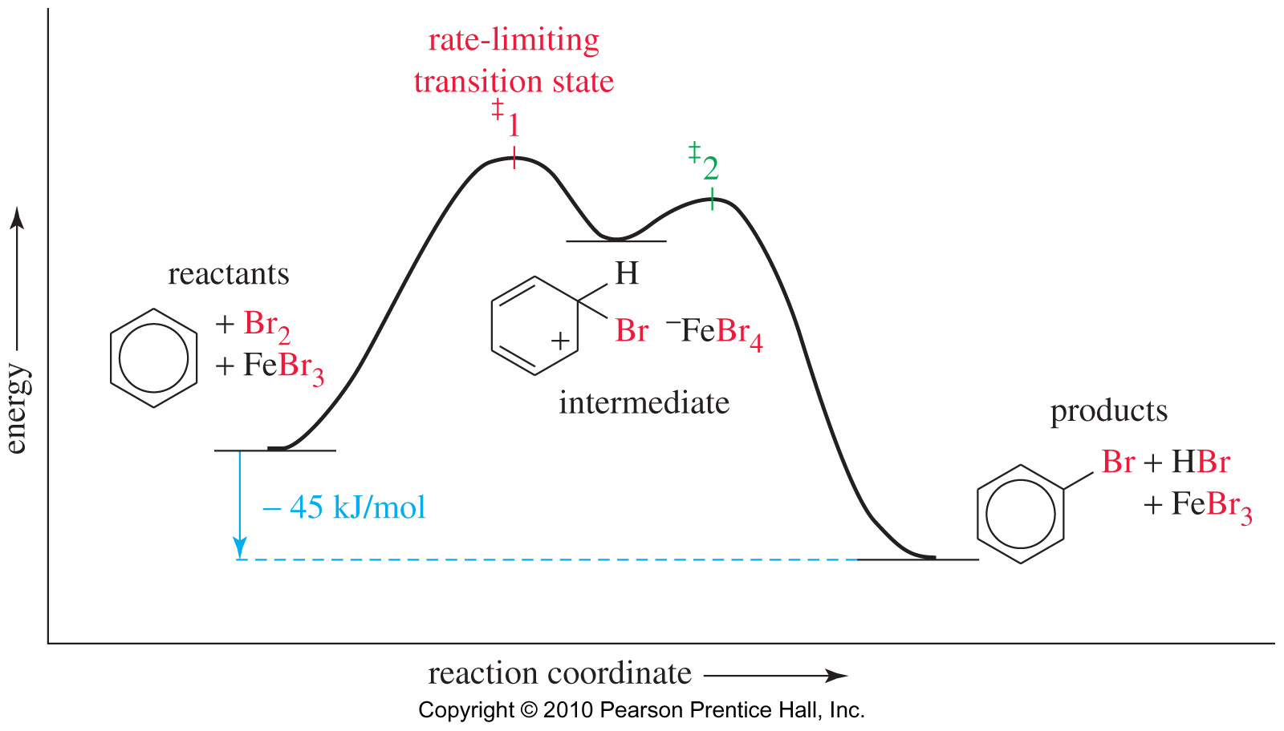
ELECTROPHILIC AROMATIC SUBSTITUTION
Bromination of Benzene: Comparison with Alkenes
Cyclohexene adds Br₂, ΔH = -121 kJ
Addition to benzene is endothermic, not normally seen.
Substitution of Br for H retains aromaticity, ΔH = -45 kJ.
Formation of sigma complex is rate-limiting.
Energy Diagram

Slide 38
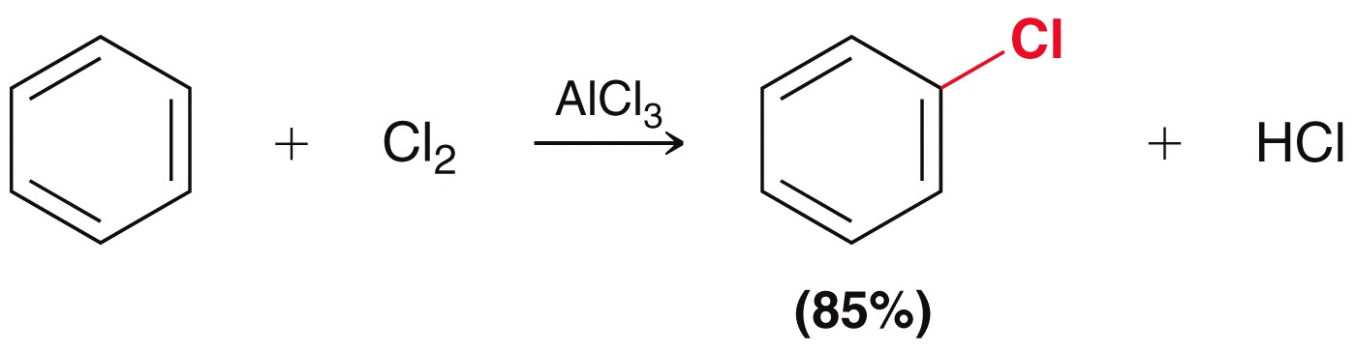

ELECTROPHILIC AROMATIC SUBSTITUTION
Chlorination of Benzene
Chlorination is similar to bromination. Use AlCl₃ as the Lewis acid catalyst.

Slide 39

ELECTROPHILIC AROMATIC SUBSTITUTION
Iodination of benzene
Iodination requires an acidic oxidizing agent, like nitric acid, which oxidizes the iodine to an iodonium ion.
Nitration of Benzene

Slide 40


ELECTROPHILIC AROMATIC SUBSTITUTION
Nitration of Benzene (Mechanism)
Sulfuric acid acts as a catalyst, allowing the reaction to be faster and at lower temperatures.
HNO₃ and H₂SO₄ react together to form the electrophile of the reaction: nitronium ion (NO₂⁺).

Slide 41

ELECTROPHILIC AROMATIC SUBSTITUTION
Sulfonation
Sulfur trioxide (SO₃) is the electrophile in the reaction.
A 7% mixture of SO₃ and H₂SO₄ is commonly referred to as “fuming sulfuric acid”.
The —SO₃H groups is called a sulfonic acid
Desulfonation
All steps are reversible, so sulfonic acid group can be removed by heating in dilute sulfuric acid.

Slide 42


ELECTROPHILIC AROMATIC SUBSTITUTION
Sulfonation: The mechanism

Slide 43

ELECTROPHILIC AROMATIC SUBSTITUTION
Because sulfonation is reversible, it can be used as a temporary blocking group

Slide 44
ELECTROPHILIC AROMATIC SUBSTITUTION
Examples: Predict the products of these reactions

Slide 45



ELECTROPHILIC AROMATIC SUBSTITUTION
Nitration of Toluene: the effect of the alkyl substitution
Toluene reacts 25 times faster than benzene. The methyl group is an activating group.
The product mix contains mostly ortho and para substituted molecules

Slide 46


ELECTROPHILIC AROMATIC SUBSTITUTION
Nitration of Toluene: the effect of the alkyl substitution
Energy Diagram

Slide 47

ELECTROPHILIC AROMATIC SUBSTITUTION
Bromination of Toluene: the effect of the alkyl substitution
Alkyl groups are activating substituents and ortho, para-directors.
This effect is called the inductive effect because alkyl groups can donate electron density to the ring through the sigma bond, making them more active

Slide 48


ELECTROPHILIC AROMATIC SUBSTITUTION
Activating: Ortho-, Para-Directing Substituents
Resonance stabilization is provided by a pi bond between the —OCH₃ substituent and the ring

Slide 49

ELECTROPHILIC AROMATIC SUBSTITUTION
The Amino Group
Aniline, like anisole, reacts with bromine water (without a catalyst) to yield the tribromide. Sodium bicarbonate is added to neutralize the HBr that’s also formed.
Strong activators

Slide 50



ELECTROPHILIC AROMATIC SUBSTITUTION
Moderate activators
Moderate activators
Weak deactivators (ortho/para directors)

Slide 51
ELECTROPHILIC AROMATIC SUBSTITUTION
Halobenzenes
Inductive Effect: Halogens are deactivating because they are electronegative and can withdraw electron density from the ring along the sigma bond, but are ortho, para-directing!
Resonance Effect: The lone pairs on the halogen can be used to stabilize the sigma complex by resonance
Ortho and para attacks produce a bromonium ion and other resonance structures.
No bromonium ion possible with meta attack.

Slide 52

ELECTROPHILIC AROMATIC SUBSTITUTION
Halobenzenes: Energy Diagram

Slide 53
ELECTROPHILIC AROMATIC SUBSTITUTION
Deactivating Meta-Directing Substituents
Electrophilic substitution reactions for nitrobenzene are 100,000 times slower than for benzene. The product mix contains mostly the meta isomer, only small amounts of the ortho and para isomers.
Meta-directors deactivate all positions on the ring, but the meta position is less deactivated.

Slide 54

ELECTROPHILIC AROMATIC SUBSTITUTION
Substitution on Nitrobenzene: Energy Diagram

Slide 55



ELECTROPHILIC AROMATIC SUBSTITUTION
Moderate deactivators
Strong deactivators
Summary of Directing Effects

Slide 56

ELECTROPHILIC AROMATIC SUBSTITUTION
Multiple Substituents
The most strongly activating substituent will determine the position of the next substitution. May give mixtures.

Slide 57



ELECTROPHILIC AROMATIC SUBSTITUTION
Multiple Substituents

Slide 58
ELECTROPHILIC AROMATIC SUBSTITUTION
Examples: How would you prepared the following compounds from a reactants of your choice
Practice 19.16 P. 900, 19.19, 19.20 P. 901-902, 19.22 P. 903, 19.25 to 9.27 P. 906
Problems 19.44 to 19.47 P. 924, 19.49 to 19.58 P. 925-926,

Slide 59


ELECTROPHILIC AROMATIC SUBSTITUTION
Friedel-Crafts Alkylation
Synthesis of alkyl benzenes from alkyl halides and a Lewis acid, usually AlCl₃.
Reactions of alkyl halide with Lewis acid produces a carbocation which is the electrophile.
Charles Friedel (12 March 1832 – 20 April 1899) was a French chemist well known for developing the Friedel-Crafts alkylation and acylation reactions and attempted to synthesize diamonds.
James Mason Crafts (March 8, 1839 – June 20, 1917) was an American Chemist who co-developed the Friedel-Crafts alkylation and acylation reactions in 1876.

Slide 60



ELECTROPHILIC AROMATIC SUBSTITUTION
Friedel-Crafts Alkylation
Other sources of carbocations: alkenes + HF, or alcohols + BF₃.
Mechanism

Slide 61



ELECTROPHILIC AROMATIC SUBSTITUTION
Friedel-Crafts Alkylation (Mechanism)

Slide 62

ELECTROPHILIC AROMATIC SUBSTITUTION
Friedel-Crafts Alkylation
Other sources of carbocations: alkenes + HF, or alcohols + BF₃.
An alkene can be protonated by HF.
This weak acid is preferred because the fluoride ion is a weak nucleophile and will not attack the carbocation.

Slide 63


ELECTROPHILIC AROMATIC SUBSTITUTION
Alcohols and Lewis Acids
Alcohols can be treated with BF₃ to form the carbocation.
Friedel–Crafts Acylation

Slide 64



ELECTROPHILIC AROMATIC SUBSTITUTION
Mechanism of Acylation
Step 1: Formation of the acylium ion
Step 2: Electrophilic attack to form the sigma complex
Practice 19.8 to 19.10 P. 889, 19.30 P. 911, 19.33 P. 913

Slide 65


ELECTROPHILIC AROMATIC SUBSTITUTION
Friedel–Crafts Acylation

Slide 66

ELECTROPHILIC AROMATIC SUBSTITUTION
Limitations of Friedel–Crafts
Reaction fails if benzene has a substituent that is more deactivating than halogens.
Rearrangements are possible.
The alkylbenzene product is more reactive than benzene, so polyalkylation occurs

Slide 67
NUCLEOPHILIC AROMATIC SUBSTITUTION
A nucleophile replaces a leaving group on the aromatic ring.
This is an addition–elimination reaction.
Electron-withdrawing substituents activate the ring for nucleophilic substitution.

Slide 68



NUCLEOPHILIC AROMATIC SUBSTITUTION
Addition-Elimination Mechanism
Step 1: Attack by hydroxide gives a resonance-stabilized complex.
Step 2: Loss of chloride gives the product Step 3: Excess base deprotonates the product.

Slide 69
NUCLEOPHILIC AROMATIC SUBSTITUTION
Benzyne Reaction: Elimination-Addition
Reactant is halobenzene with no electron-withdrawing groups on the ring.
Use a very strong base like NaNH₂.
Sodium amide abstract a proton.
The benzyne intermediate forms when the bromide is expelled and the electrons on the sp2 orbital adjacent to it overlap with the empty sp2 orbital of the carbon that lost the bromide.
Benzynes are very reactive species due to the high strain of the triple bond.
Practice 19.35, 19.36 P. 915, 19.40 P. 919

Slide 70



NUCLEOPHILIC AROMATIC SUBSTITUTION
Benzyne Intermediate (mechanism)

Slide 71


NUCLEOPHILIC AROMATIC SUBSTITUTION
Benzyne Intermediate
Further evidence for the existence of the benzyne intermediate can be seen when the benzyne is allowed to react with a diene via a Diels Alder reaction.
The flow chart below can be used to identify the proper substitution mechanism.

Slide 72

NUCLEOPHILIC AROMATIC SUBSTITUTION
Diazonium ions
This reaction involves aromatic diazonium ions, which are prepared from the reaction of amines with sodium nitrile and acid. These ions are highly reactive because the leaving group (N₂⁺) is an extremely weak base.
The diazo group can then be replaced by number of different nucleophiles. These reactions are known as Sandmeyer reaction
Traugott Sandmeyer (September 15, 1854 – April 9, 1922) was a Swiss Chemist known for the development of nucleophilic substitution on aromatic systems known as Sandmeyer reactions he discovered 1884. He was a professor of organic chemistry, although he never graduated with a degree in chemistry.

Slide 73
NUCLEOPHILIC AROMATIC SUBSTITUTION
Sandmeyer reactions

Slide 74
NUCLEOPHILIC AROMATIC SUBSTITUTION
Examples: How would you prepared the following compounds from a reactants of your choice
Problems 19.66 to 19.72 P. 926-927

Slide 75
OTHER REACTION ON THE BENZENE RING
Chlorination of Benzene
Addition to the benzene ring may occur with high heat and pressure (or light).
The first Cl₂ addition is difficult, but the next 2 moles add rapidly.
The product, benzene hexachloride, is an insecticide.
Catalytic Hydrogenation
Elevated heat and pressure are required.
Possible catalysts: Pt, Pd, Ni, Ru, Rh.
Reduction cannot be stopped at an intermediate stage

Slide 76


OTHER REACTION ON THE BENZENE RING
Birch Reduction: Mechanism

Slide 77
OTHER REACTION ON THE BENZENE RING
Limitations of the Birch Reduction
A carbon bearing an electron-withdrawing group is reduced
A carbon bearing an electron-releasing group is not reduced
Practice 18.24 P. 861

Slide 78
OTHER REACTION ON THE BENZENE RING
Oxidation of phenols
Hydroquinone is used as a developer for film. It reacts with light-sensitized AgBr grains, converting it to black Ag.
Coenzyme Q is an oxidizing agent found in the mitochondria of cells

Slide 79
SUMMARY

